Slide 1
APPLICATIONS OF MACHINE LEARNING TECHNICAL FOR VERIFICATION OF STUDENT IDENTITY
Authors: Nguyen Thanh Dat, Ngo Dinh An, Pham Quoc Hung, Truong Trong Tien
Mentor: Phan Thi Le Thuyen
Affiliation: FPT University Quy Nhon

Slide 2





Research Team
Authors
Nguyen Thanh Dat
Ngo Dinh An
Pham Quoc Hung
Truong Trong Tien
Mentor
Phan Thi Le Thuyen

Slide 3
Table of contents
01
02
03
04
Introduction
System Overview
Methodology
Experiments
05
06
Expected Result
Review and evaluation

Slide 4
01
Introduction

Slide 5

The neccessity of research
Impersonation during exams
Issues:
+ Faint ID cards’ image
+ Changes of students’ appearance
+ Easy fabrication of ID cards
FAKE
It is necessary and scientifically meaningful to build a student identification support system.

Slide 6
System Description
02

Slide 7
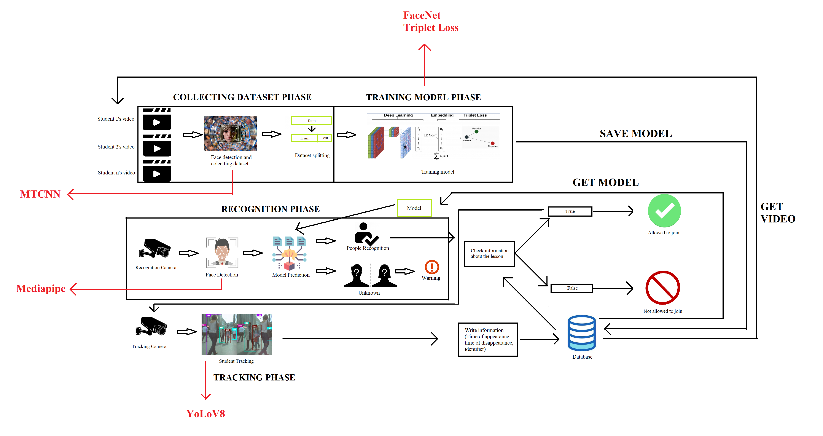
SYSTEM OVERVIEW

Slide 8
03
Methodology

Slide 9
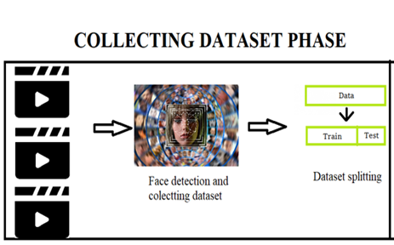
Collecting data
Main source of data: Self-recorded videos of examinees’ faces for over 30 seconds.
Face detection.
A dataset of 300 pictures was collected and saved in separate folders with corresponding object labels.

Slide 10
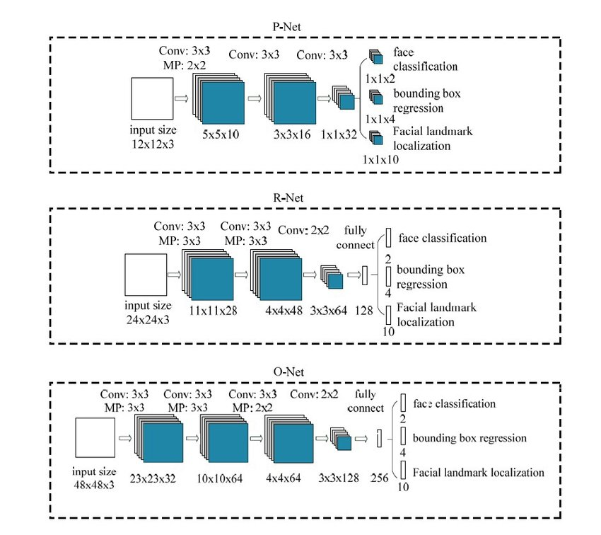
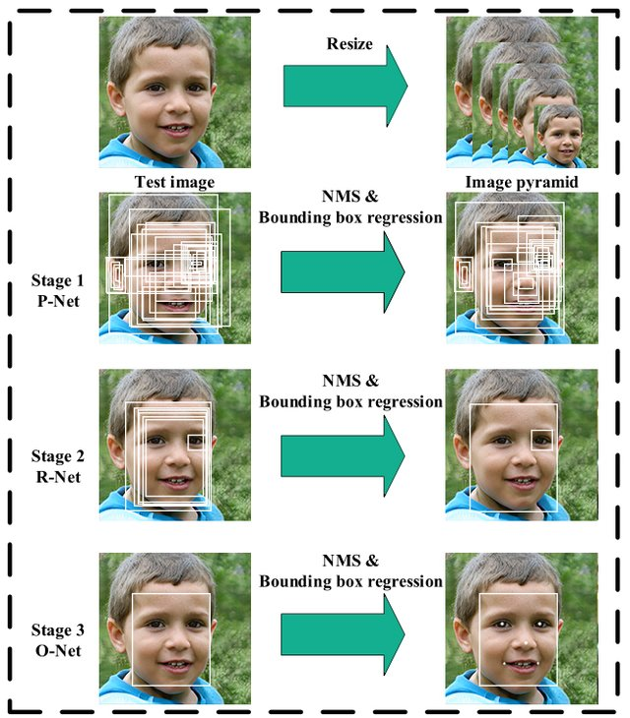
MTCNN
https://s.net.vn/C6Vm
https://s.net.vn/pzyQ

Slide 11
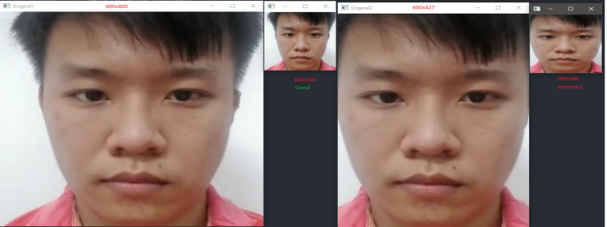
Solutions to distorted faces

Slide 12
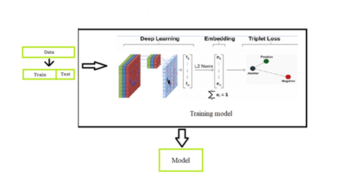
Training Model

Slide 13
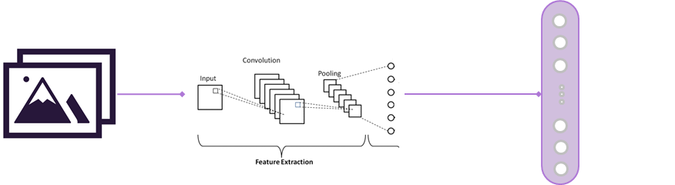
FaceNet
embedding
vector

Slide 14
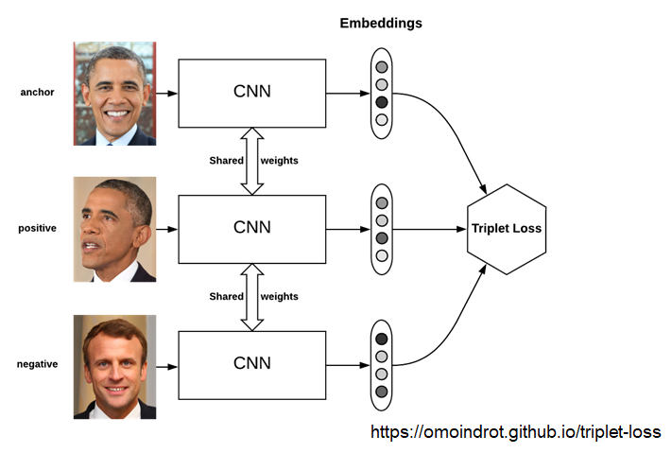
FaceNet

Slide 15
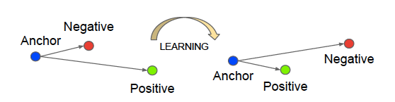
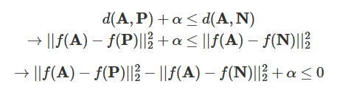
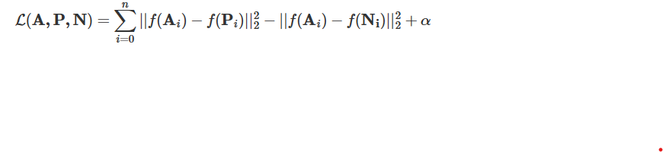
d(A,P)>d(A,N)
d(A,P)<d(A,N)
Triplet Loss Function
https://tinyurl.com/2elopqjh

Slide 16
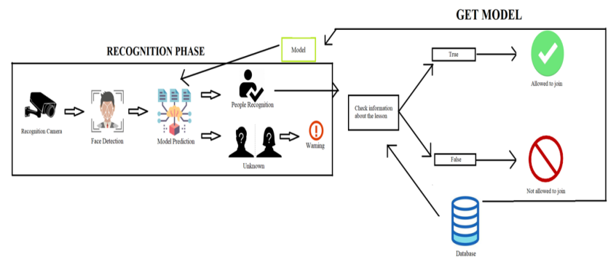
- Student recognition - Using Mediapipe
- Check and Get ID

Slide 17
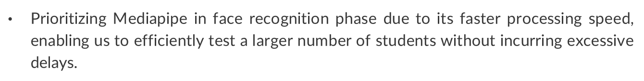
MTCNN vs Mediapipe
 | Mediapipe | MTCNN
Time (s) | 2.4218 | 161.3650
Detection rate (%) | 90 | 99.5
Average time/frame (only detected) (s) | 0.01345 | 0.8109
Average time/frame (not detected included)(%) | 0.0121 | 0.8068
Prioritizing Mediapipe in face recognition phase due to its faster processing speed, enabling us to efficiently test a larger number of students without incurring excessive delays.

Slide 18
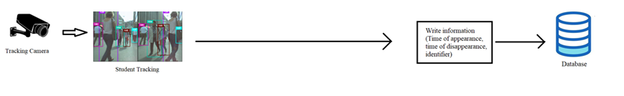
Tracking Phase
Students tracking when entering the room
Using YoLoV8

Slide 19
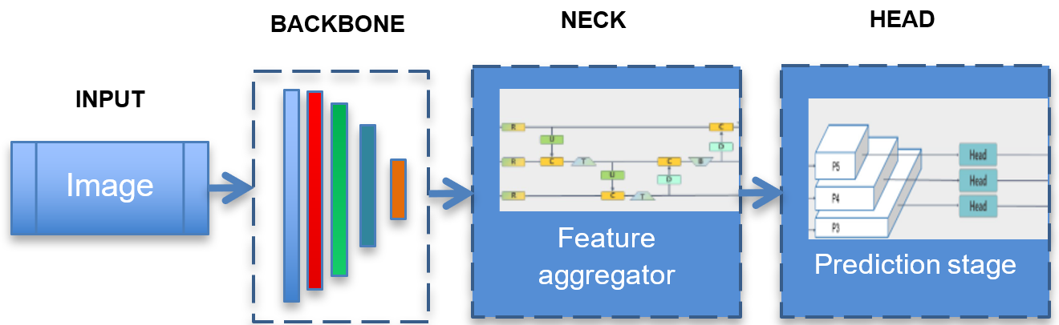
YOLOv8
The backbone extracts features using a pre-trained convolutional neural network.
The neck aggregates feature maps from different backbone stages.
The head analyzes concatenated features to generate predictions for bounding boxes, objectness scores, and classification scores.

Slide 20
04
Experiment

Slide 21
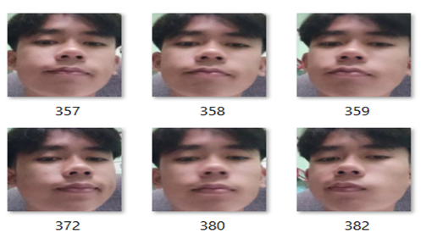
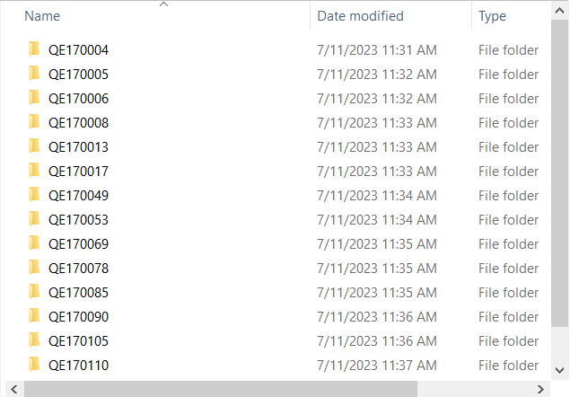
Data collecting and processing
Applied dataset: All students of class AI17B, Quy Nhon Campus, FPT university.
Data collection :
Record their face video and submit
Check videos’ quality through multiple requirements
Save all images in a folder with their name and ID.
Data processing:
Extract the frames from the video using MTCNN
Resized each frame to the size of (160, 160, 3)
Save all frames in folders with respective ID.

Slide 22
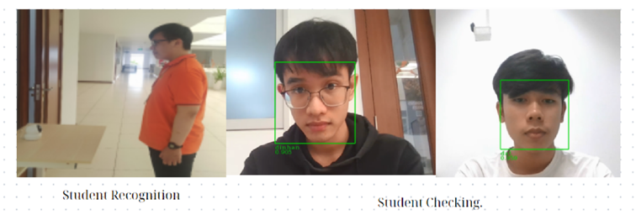
Student Recognition
Place a camera in front of the entrance of the room to capture the students' faces.
Check database to filter out the list of students who had scheduled exams on a specific day.
Set a recognition threshold of about 80% out of 50 successful detections.
Recognized: Retrieve the student ID associated with that recognition.
Not recognized: Raise a warning about an unrecognized student and denied access.

Slide 23
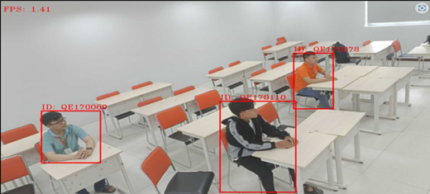
Student Tracking

Slide 24
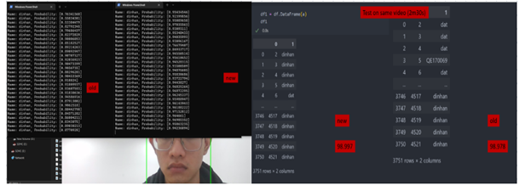
Avoiding mold distortion
Using the bounding box method of MTCNN and the bounding box processing method.
Improved model show accuracy on each frame significantly increased
The rate of wrong object recognition also improved increased by a tiny amount.

Slide 25
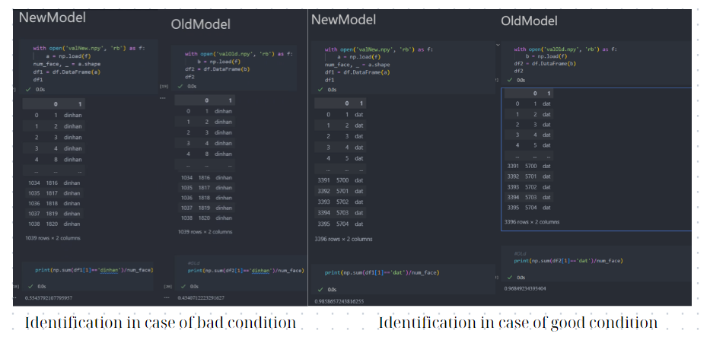
Original FaceNet vs Proposed model
Bad condition: Accuracy of both models is quite low (43% and 55%)
Ideal condition: Both models obtain high accuracy (96.55% and 98.59%)

Slide 26
FileVideoStream vs Default OpenCV
FileVideoStream generally achieved higher frames per second (fps) compared to the OpenCV of YoLoV8. Sometimes, FileVideoStream is slightly lower.
Reasons:
Limitations in the algorithm used for deep sort tracking.
Hardware and equipment of the system may not be well-suited for the task.
 | FileVideoStream | Default OpenCV
Average (???????????) | 2.4218 | 161.3650
Delay time in beginning (s) | 15 | 45

Slide 27
06
Review and Evaluation

Slide 28

Review
Achivement
Build a facial recognition system to identify candidates in the exam room
using FaceNet, MTCNN, Mediapipe, and YOLO8.
Accuracy
Achieve 96.55% and 98.59% of recognition for ideal condition.

Slide 29


Evaluation
Limit
Not perform well in bad recognition conditions due to several reasons: dataset quality, video quality, computer hardware, algorithms
Future Development
Security for face, avoiding fake 2D image, …

Slide 30
Thank you for your attention!

